Slide 1
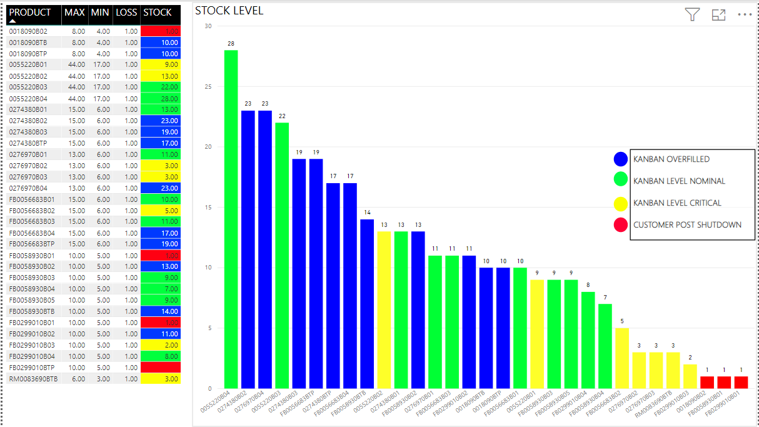
Stock Level Tracking

Slide 2
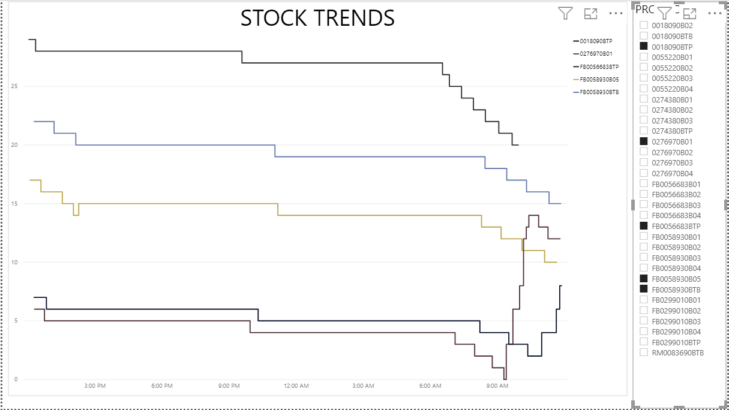
Stock Level Trends

Slide 3
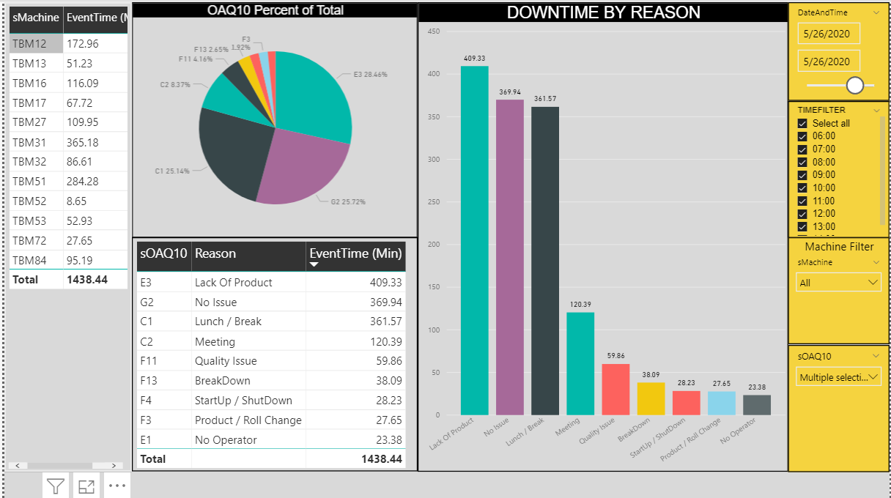
Downtime

Slide 4
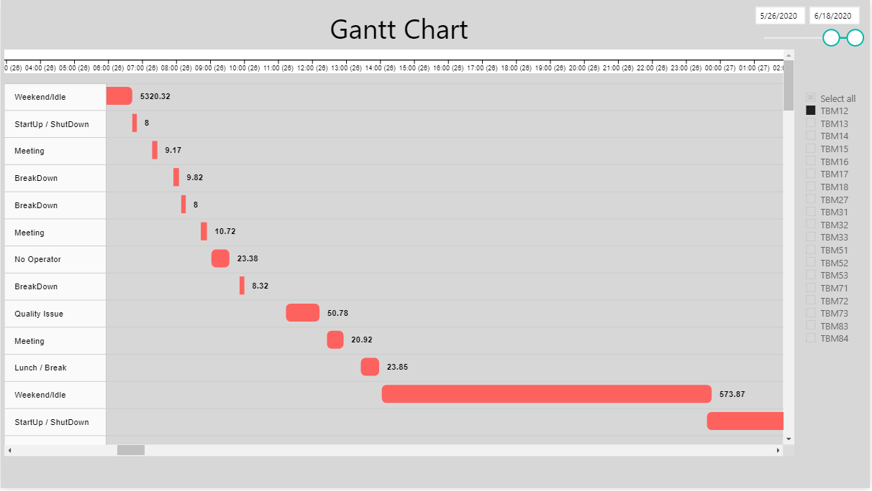
Downtime Gantt Chart

Slide 5
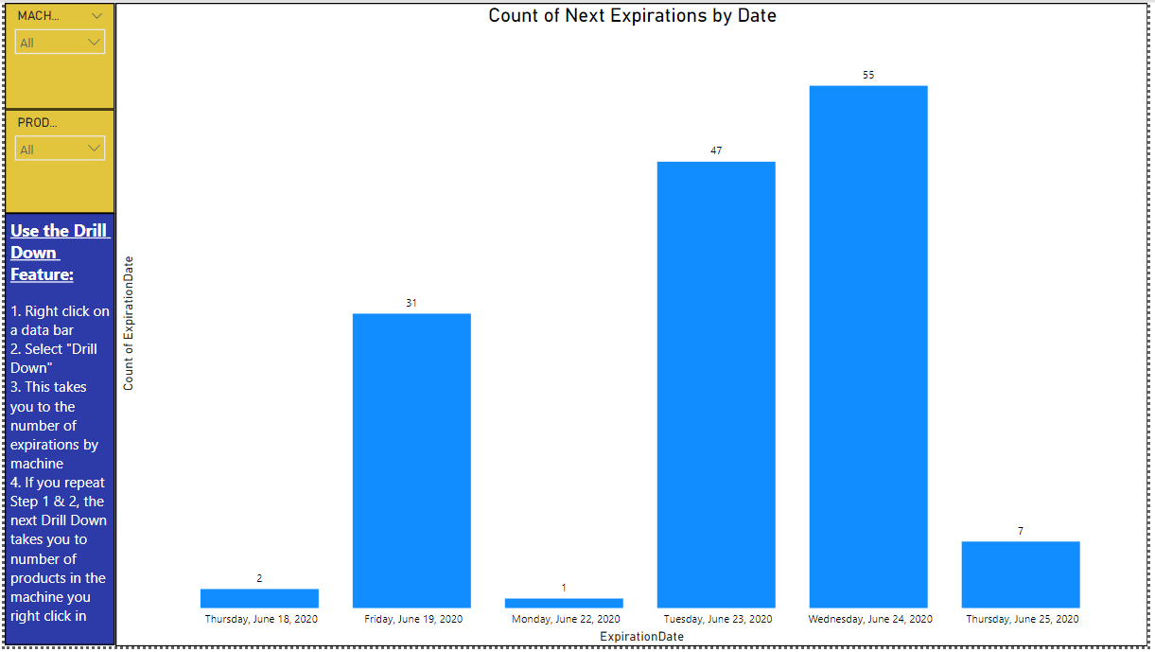
Tracking Expiring Materials

